Slide 1
What is modern SharePoint?
Michael Panciroli
PTA
Bob German
PTA

Slide 2
Modern SharePoint
Share & work together
Inform & engage
Transform business processes
Harness Collective Knowledge
IT Controls
Extend & Develop
Notes:
SharePoint and OneDrive play a special role in Office 365, by connecting the workplace with intelligent content management and intranets.
Today we’re going to focus on key areas where you can leverage our innovations to achieve significant benefits. Specifically, how you can:
…inside and outside your organization through anywhere access to your content and seamless collaboration experiences.
…people by connecting them with the resources they need to do their jobs and fostering open conversations.
…by automating repetitive tasks and streamlining workflows.
…by making it easier to find information and expertise right when it's needed, and to encourage best practice sharing.
All with the with full confidence that you can protect and manage your organization’s content as well as extend and develop on SharePoint to meet your unique business needs. Let’s get started!

Slide 3
Share and work together
Notes:
SPEAKER NOTES
More than ever, how people interact with technology is much more than “look and feel.” Great experiences are those that look great and work flawlessly. They entertain and engage, with rich, contextual, and relevant content. They are easy to use. And they ensure reliability, performance, and security under real-world pressures of scale and complexity.

Slide 4
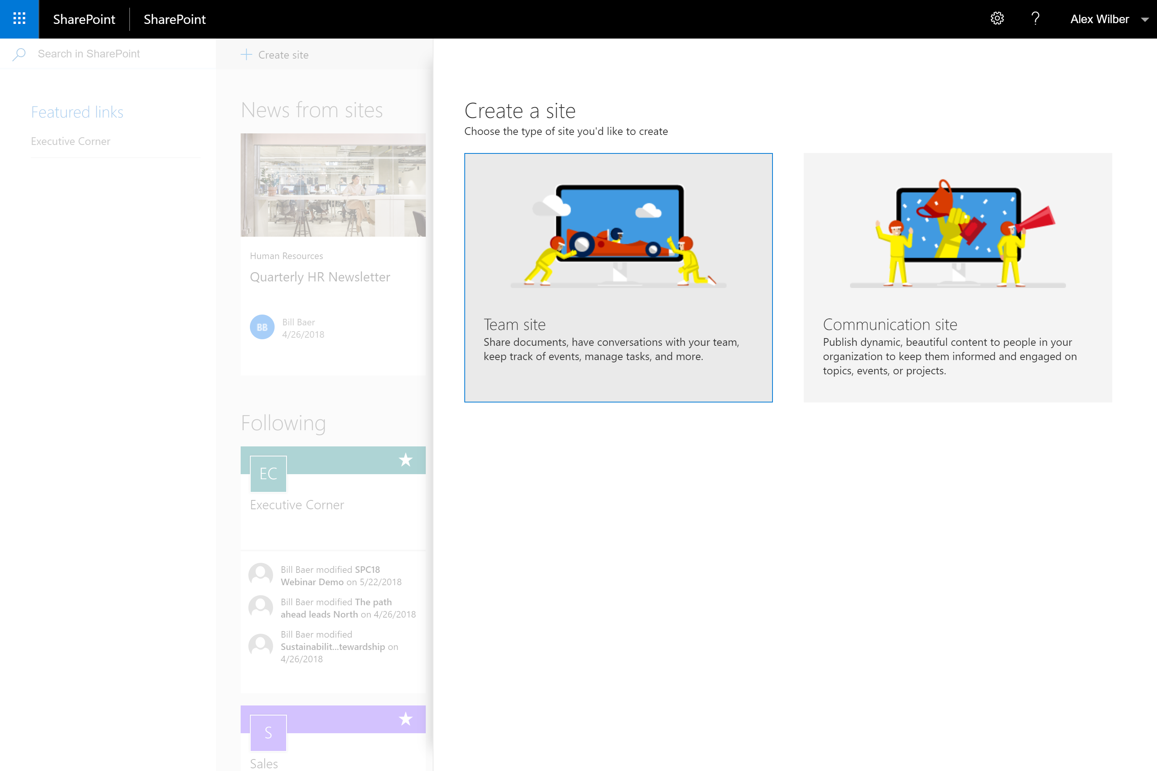
Site Creation
Simple site creation
Experience for Teams and Communication sites
Fast site creation
OneDrive personal sites
Modern Team sites
Communication sites
Notes:
Create sites in seconds… Fast site creation in SharePoint Online allows users create new sites in a few seconds. Fast site creation is only supported with the following site templates:
OneDrive personal site [SPSPERS#10]
Team site (modern only) [STS#3]
Communication site [SITEPAGEPUBLISHING#0]
Fast site creation is used when creating sites in the following entry points:
OneDrive personal site auto-provisioning
The Create Site button in SharePoint Home
The New-SPSite PowerShell cmdlet with the -CreateFromSiteMaster switch parameter#

Slide 5
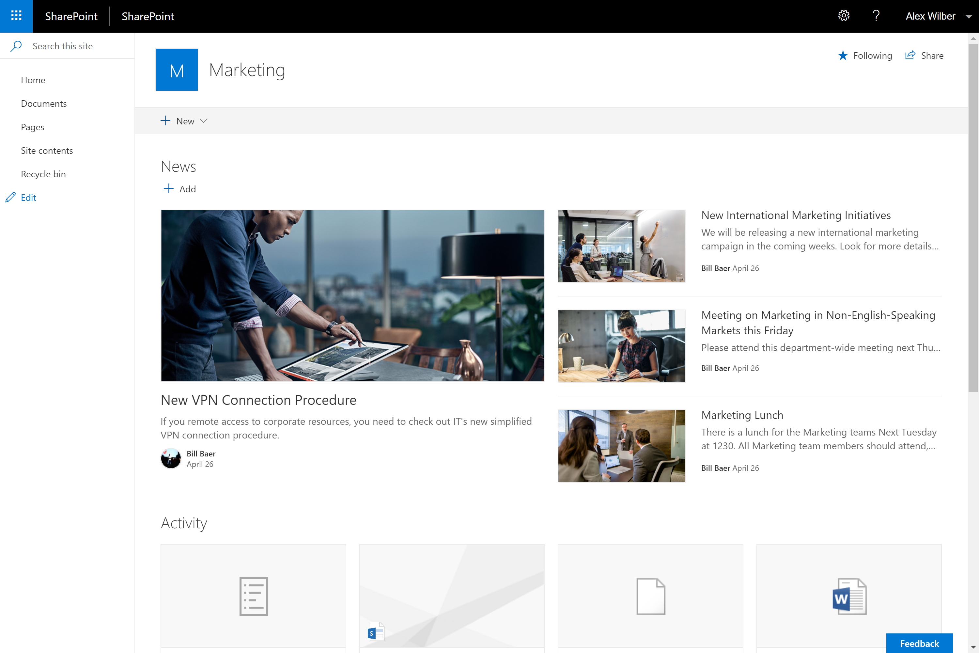
Modern Team sites
Updated lists, libraries, pages and news
Fast, mobile ready, and customizable experience
Notes:
Modern Team Sites
A SharePoint team site connects you and your team to the content, information, and apps you rely on every day.
Team sites have always been at the heart of collaboration with SharePoint. They connect your team with the content, the information and the apps you rely on and they enable sharing and communication within the team and across the organization.
engaging home page personalized by the power of SharePoint search.

Slide 6
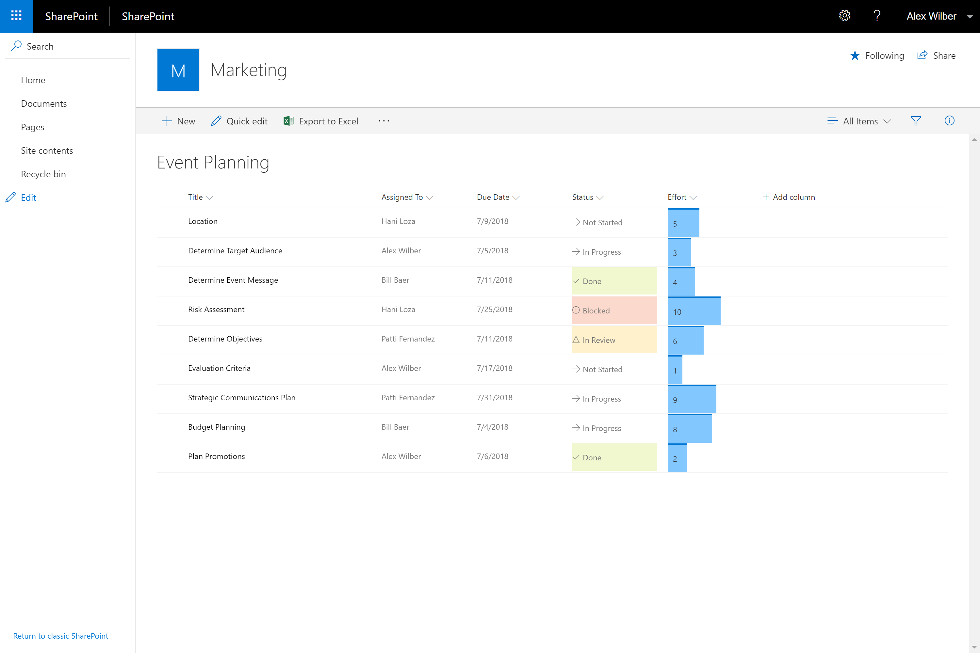
Modern Lists
Add columns and rows with ease
Format columns with JSON
Simplified filtering experience
Details pane gives you more information without leaving the list view
Easier filtering
Attention Views
Automatic column indexing (for >5,000 items!)
Pin items and Filters
Library Tile View
Notes:
SharePoint lists provide individual and teams the ability to access, share, and collaborate around structured data and to bring information from other systems into SharePoint to support business process.
simplifies how people create, curate, and interact with information with a rich set of capabilities that work across devices and browsers.

Slide 7
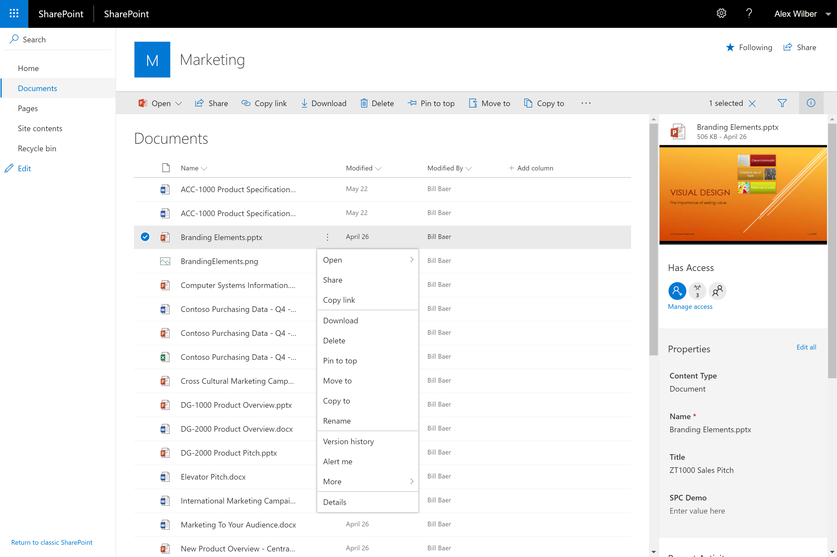
Modern Libraries
Updated, responsive UI
Aligned with UI fabric of OneDrive
Modern sharing experience
Optimized for light weight structure and process
Notes:
Modern Libraries
Helping people share files and collaborate on content has always been central to SharePoint.
faster, more intuitive and responsive
Modern document libraries have an updated user interface that offers an experience similar to OneDrive, so it’s more intuitive to create a new folder and upload files in the browser.
The ribbon has been replaced with a trim command bar, which provides intelligent commands relevant to the tasks at hand.
Rich Previews of documents

Slide 8
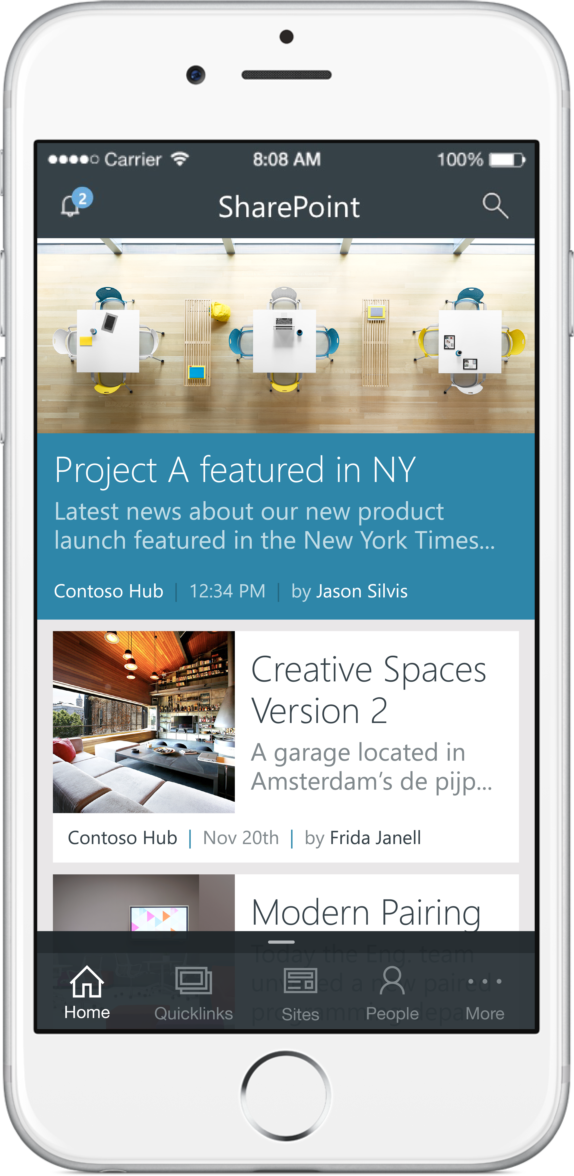
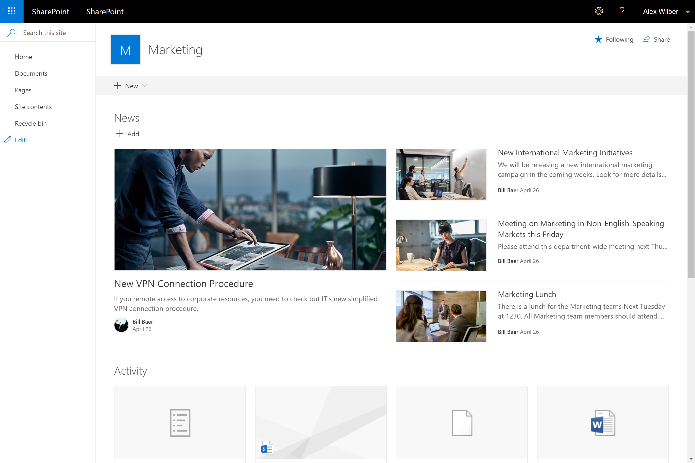
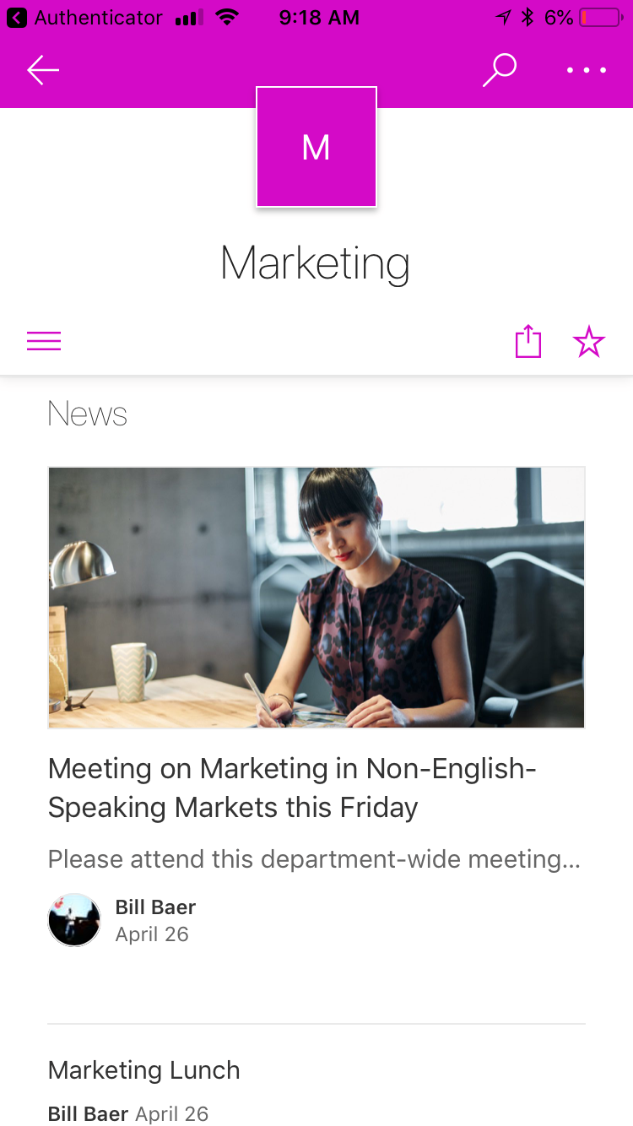
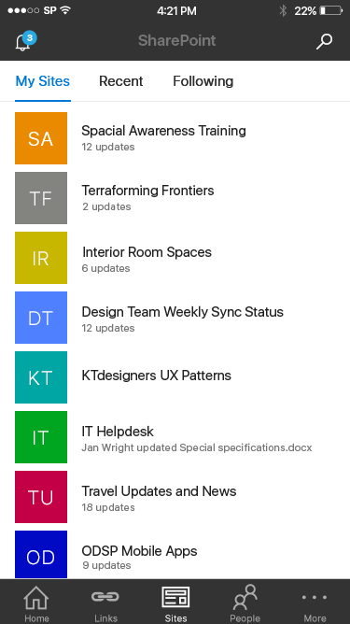
Mobile
Beautiful sites on every device
Get SharePoint on the go with the SharePoint Mobile App
Notes:
SharePoint mobile app
Intranet in your pocket
Optimized for on the go consumption and notifications – not only consume but also contribute news and information within their teams and across the organization. It manages knowledge and connects users to content through navigation and search. It hosts applications that support and automate business processes.
More intelligent, and more personalized, based on your activities across sites, the people you work with, the content you work on and the business processes you drive.

Slide 9
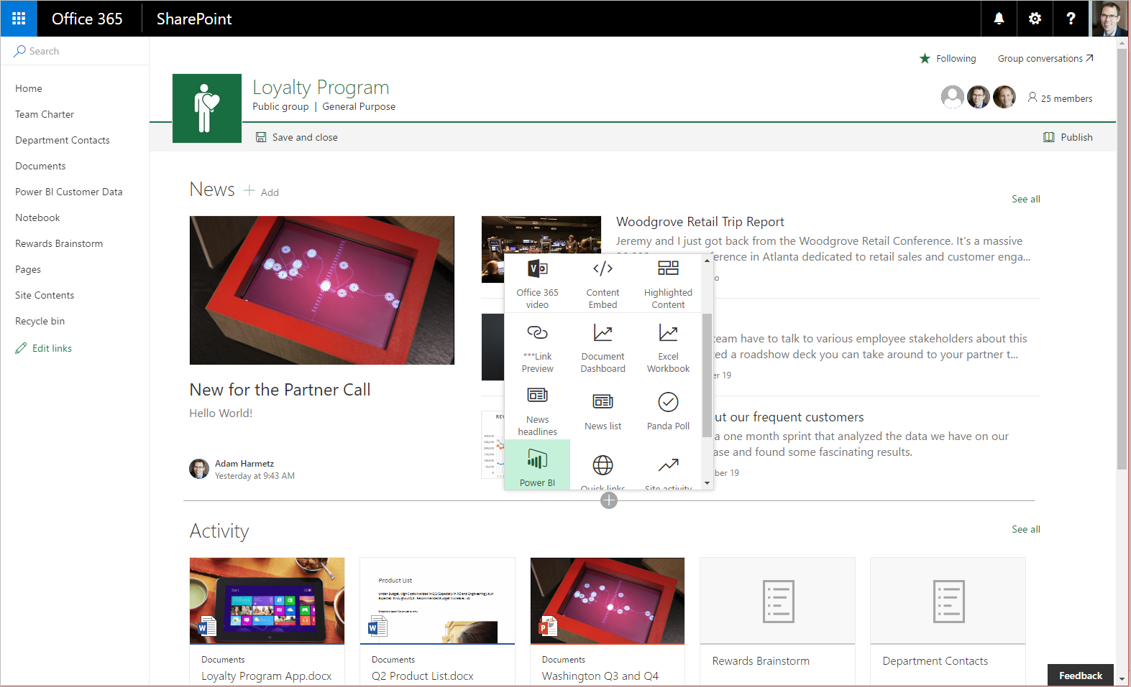
Editable Home Page
Notes:
Toolbox

Slide 10
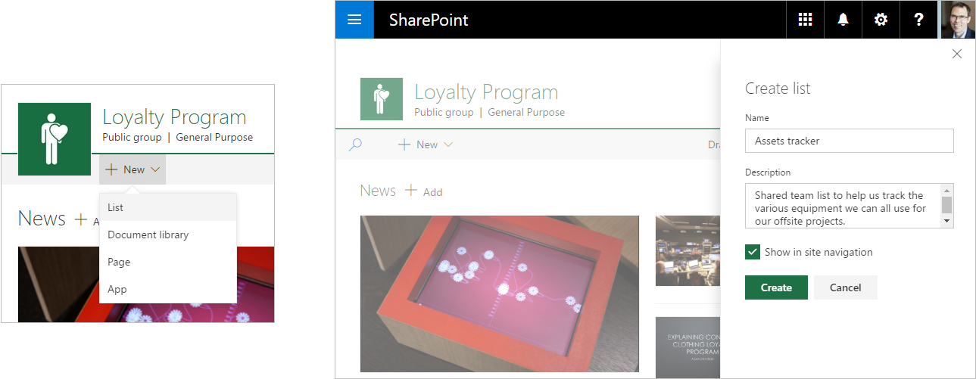
Modern Create Panel for new libraries and lists

Slide 11
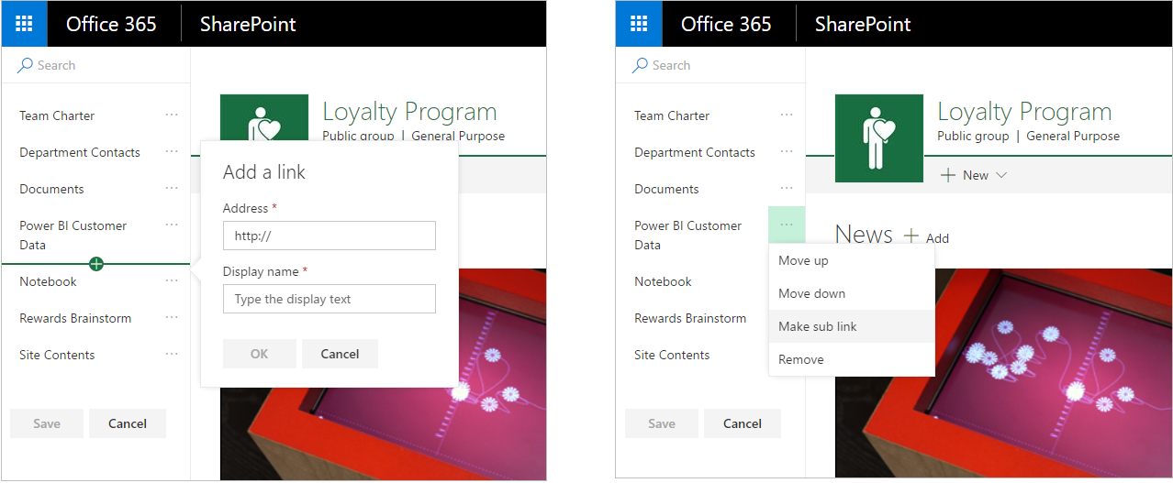
In-place navigation Editing

Slide 12
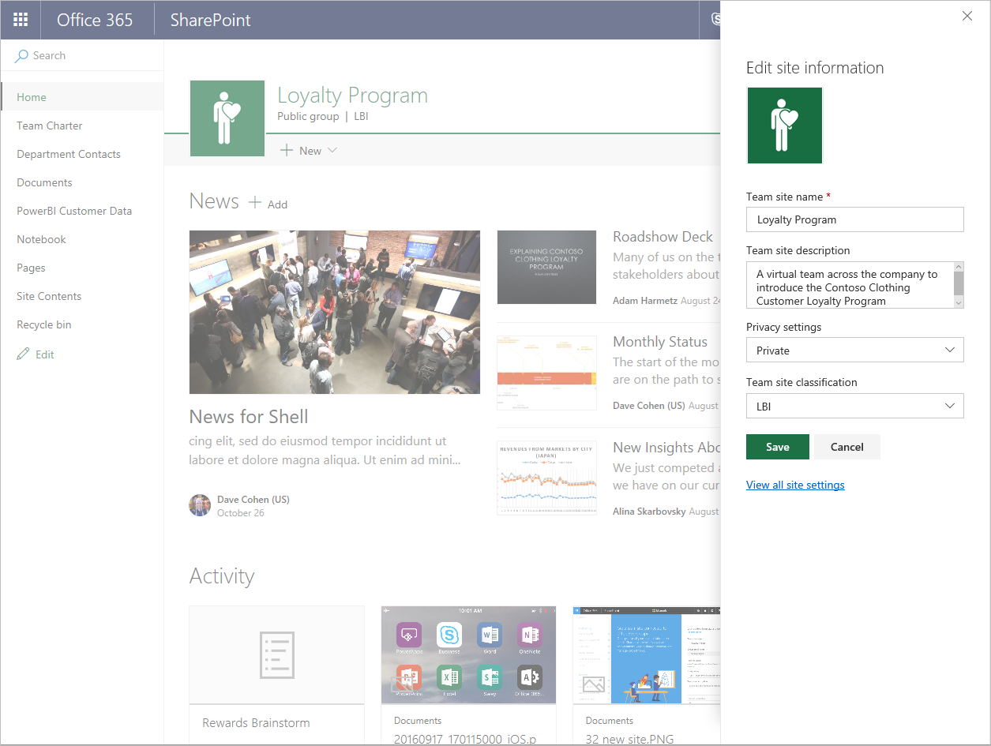
Site Information

Slide 13
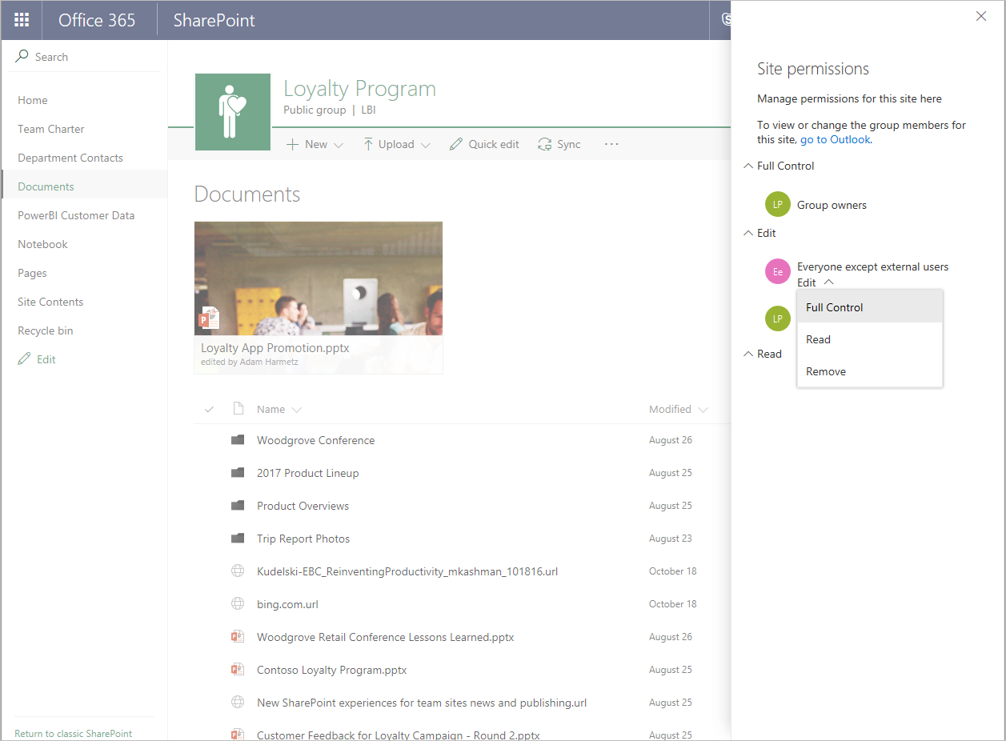
Site Permissions

Slide 14
Inform and engage
Notes:
SPEAKER NOTES
Across your business exist valuable ideas and information. As a core part of your collaboration and communications strategy, SharePoint Online provides content management and collaboration capabilities that are seamlessly integrated with the other applications people use every day to create and co-author documents, meet and work with their teams, brainstorm, analyze and make decisions. SharePoint Online can also be integrated with the powerful cross-suite capabilities of Office 365, such as OneDrive for Business, the Office Graph, and additional governance controls for security, privacy and compliance when choosing an Office 365 coexistence solution.

Slide 15
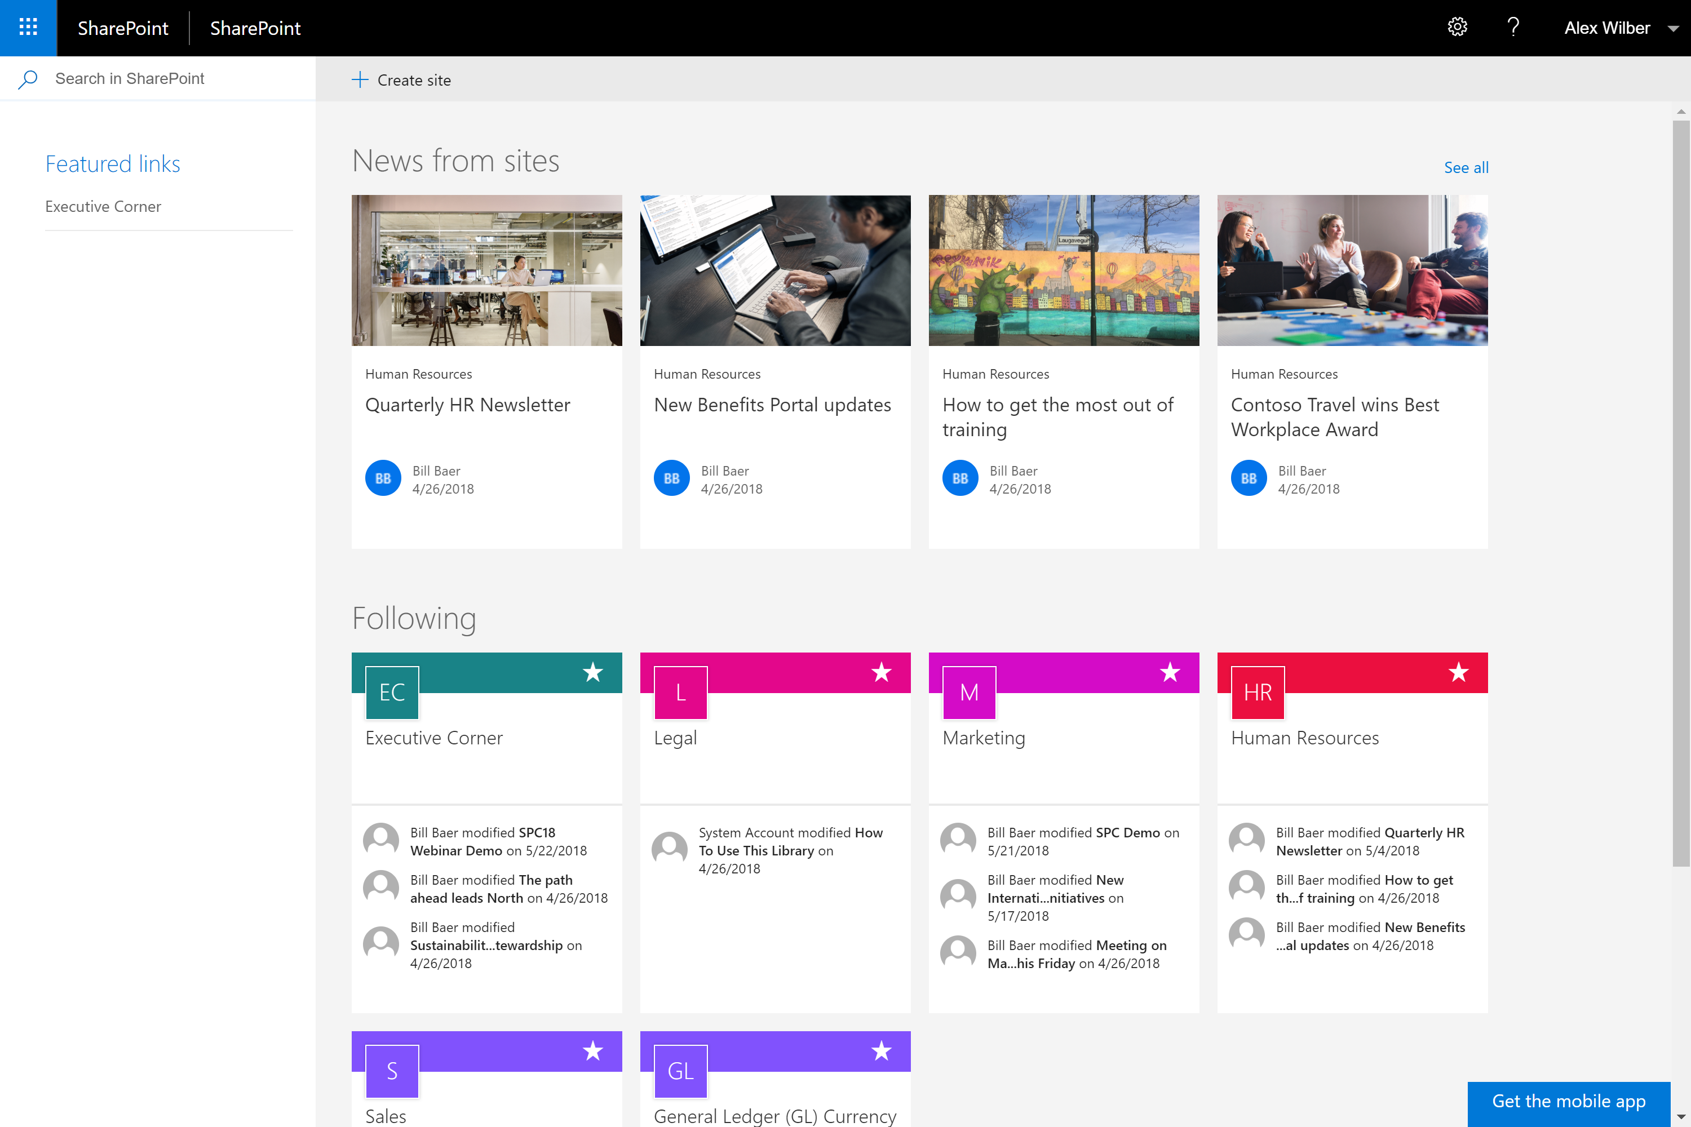
SharePoint Home
New SharePoint sites page
Most relevant sites in one place
Notes:
SharePoint Home
The new SharePoint home page in SharePoint Online provides unified access to all of your sites—online and on-premises—and lets you navigate seamlessly through your intranet, as well as catch up with activity across your sites with just a glance.

Slide 16
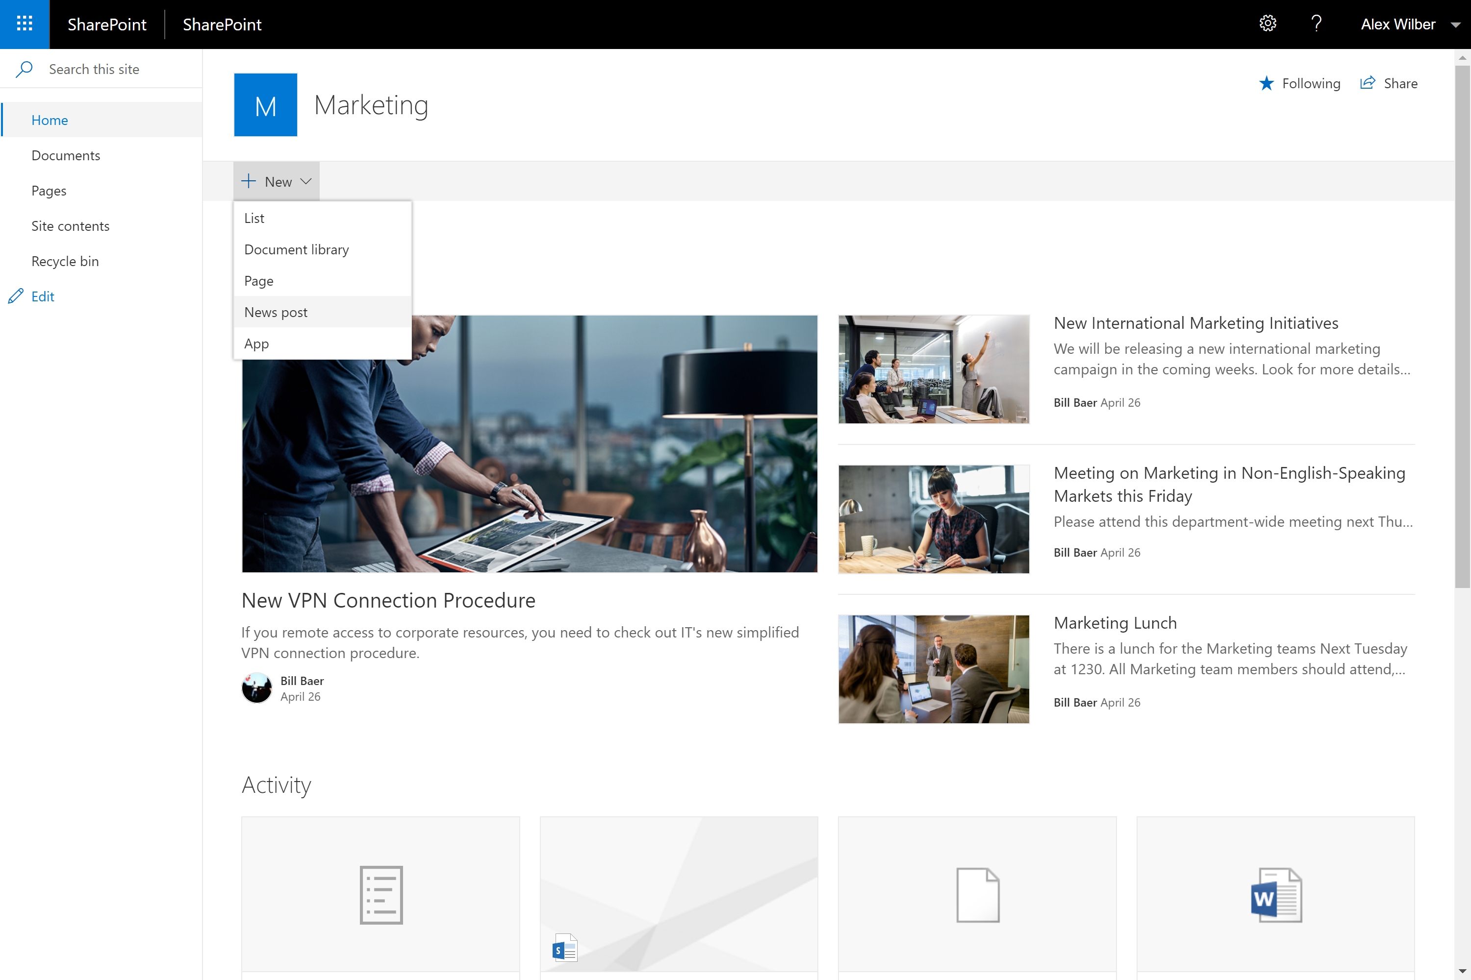
Team News
Keep up with and broadcast key events and accomplishments with other members of the team
Notes:
Team News
s how you keep up with and broadcast key events and accomplishments with other members of the team and extended stakeholders.
Use for things like trip reports, best practices, project updates, highlights of new documents and content, welcoming a new team member, sharing team goals and celebrating milestones.
You can easily and quickly create beautiful posts that are showcased on your modern team’s home page.

Slide 17
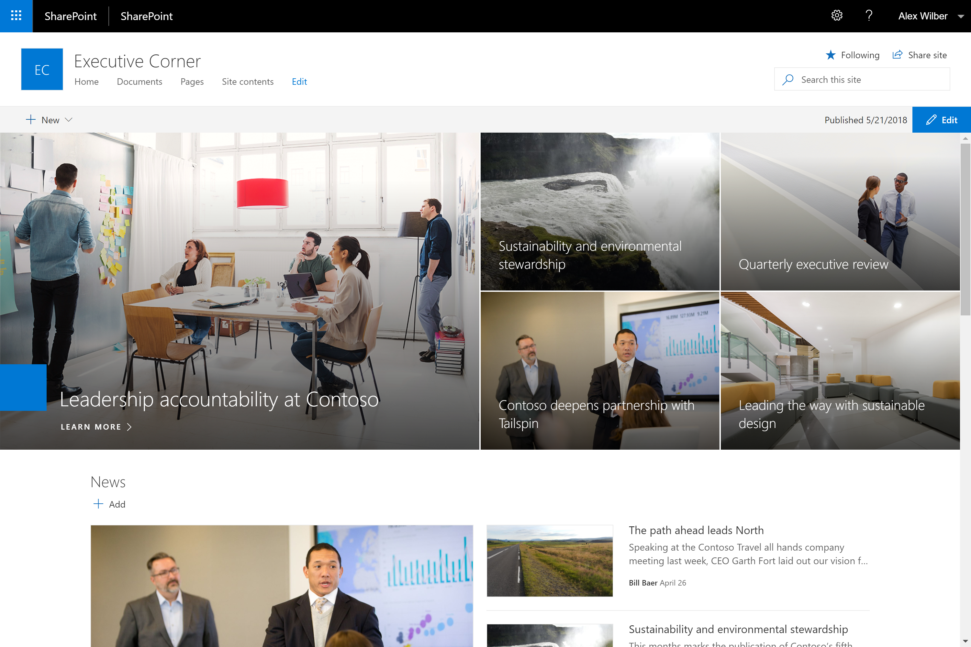
Communication Sites
Beautiful, dynamic site to reach broad audience
Keep the organization informed and engaged
Notes:
Communication Sites
This is a new site template that allows you to communicate to people throughout your organization with beautiful, dynamic, mobile-ready communication sites and pages that keep everyone informed and engaged.
It is easy to move from working on the details of a project or campaign collaboratively in team sites to create broad-reach communication sites.
Created in seconds by clicking Create site on SharePoint
adjust page layouts and add web parts and to pull in valuable data and content from other services, like conversations from Yammer and videos from Microsoft Stream.

Slide 18
SharePoint sites: building blocks for your intranet
your sites
Team sites
Communication sites
Department
Initiative, campaign or event
Team
Share work with organization
Project
Community of practice or interest
Extranet (Partner, Customer)
Training and policies
Committee (Planning, Executive)
Updates and reports
Connect, Create & Collaborate
Story, Showcase & Services

Slide 19
SharePoint sites: building blocks for your intranet
Team sites
Communication sites
Create a web site that’s fast and mobile-ready
Share news & information on beautiful pages with engaging & dynamic web parts
Stay up-to-date with news and activity
Share files and data with libraries and lists
Create customized forms & experiences with PowerApps, automate process with Flow
Site design: team site
Site designs: Topic, Showcase, Blank
Office 365 group with default access
Site owner assigns permissions
Shared inbox, calendar, Planner, Stream channel, Power BI, Microsoft Teams
Future: Yammer on by default
Created by users or admins
Created by users or admins

Slide 20
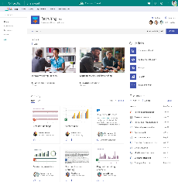
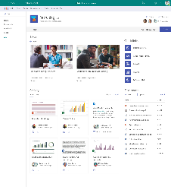
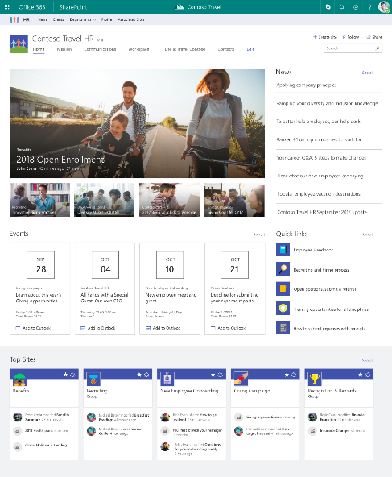
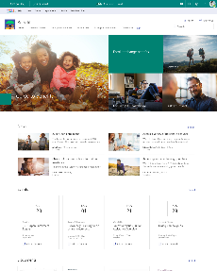
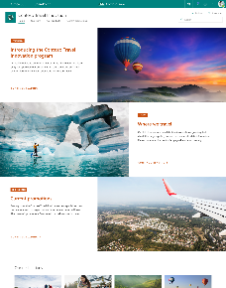
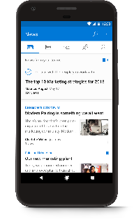
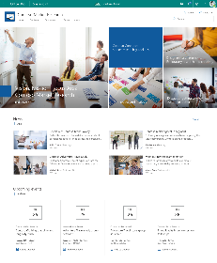
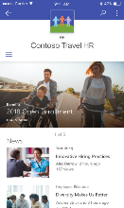
Hub Sites
team sites
hub site
Brings together related team sites and communication sites
Roll up news and site activity
Search across related sites
Cross-site navigation
Consistent look-and-feel across sites
Admins create, users adopt and use
communication sites

Slide 21
SharePoint sites: building blocks for your intranet
Hub sites
Team sites
Communication sites
A communication site or team site
Created by users or admins
Created by admins
Created by users or admins
Navigation
Theme and logo
Search scope
News and activity rollup
Notes:
https://docs.microsoft.com/en-us/sharepoint/planning-hub-sites

Slide 22



A dynamic, ever-changing digital workplace
Acquired sales
Travel innovation
Vendor agreements
Customer connections
Legal portal
Travel
Programs
Company-wide
Quarterly reports
Regional sales
Sales
Expense tracker
Cultural
Eco
Records center
Adventure
Benefits
planning
Big wins
Customer
Event planning
Benefits
Regional partner outreach
Recognition & rewards
New hires
EMEA
EMEA sales
Policies
key
HR
Hub site
Communication site
Team site
Partner solution
Custom portal

Slide 23
A dynamic, ever-changing digital workplace
Acquired sales
Travel innovation
Vendor agreements
Customer connections
Legal portal
Travel
Programs
Regional sales
Company-wide
Quarterly reports
Sales
Expense tracker
Cultural
Eco
EMEA sales
Records center
Adventure
Benefits
planning
Big wins
Customer
Event planning
Benefits
Regional partner outreach
New hires
EMEA
Recognition & rewards
Policies
key
HR
Hub site
Communication site
Team site
Partner solution
Custom portal

Slide 24
Important Points
Sites associated with a SharePoint hub site don't inherit the permissions of the hub site or any other sites associated with it.
Hub settings will only appear on modern pages
You can create up to 100 hub sites for an organization
No limit to the amount of associated sites
A lot of the Hub functionality is Search driven. You may need to wait for Indexing to occur for content from the associated sites to appear
Cannot cross geos in a multi-geo tenant
A great replacement for sub-sites!

Slide 25
Transform business processes
Notes:
SPEAKER NOTES
Achieving digital transformation and delivering business value requires new tools and techniques for reinventing business process.
No-code and low-code applications have been essential tools in SharePoint for a long time, SharePoint provides new solutions to building robust business solutions with new list and library experiences to improved support of Flow, Microsoft PowerApps, and more.

Slide 26
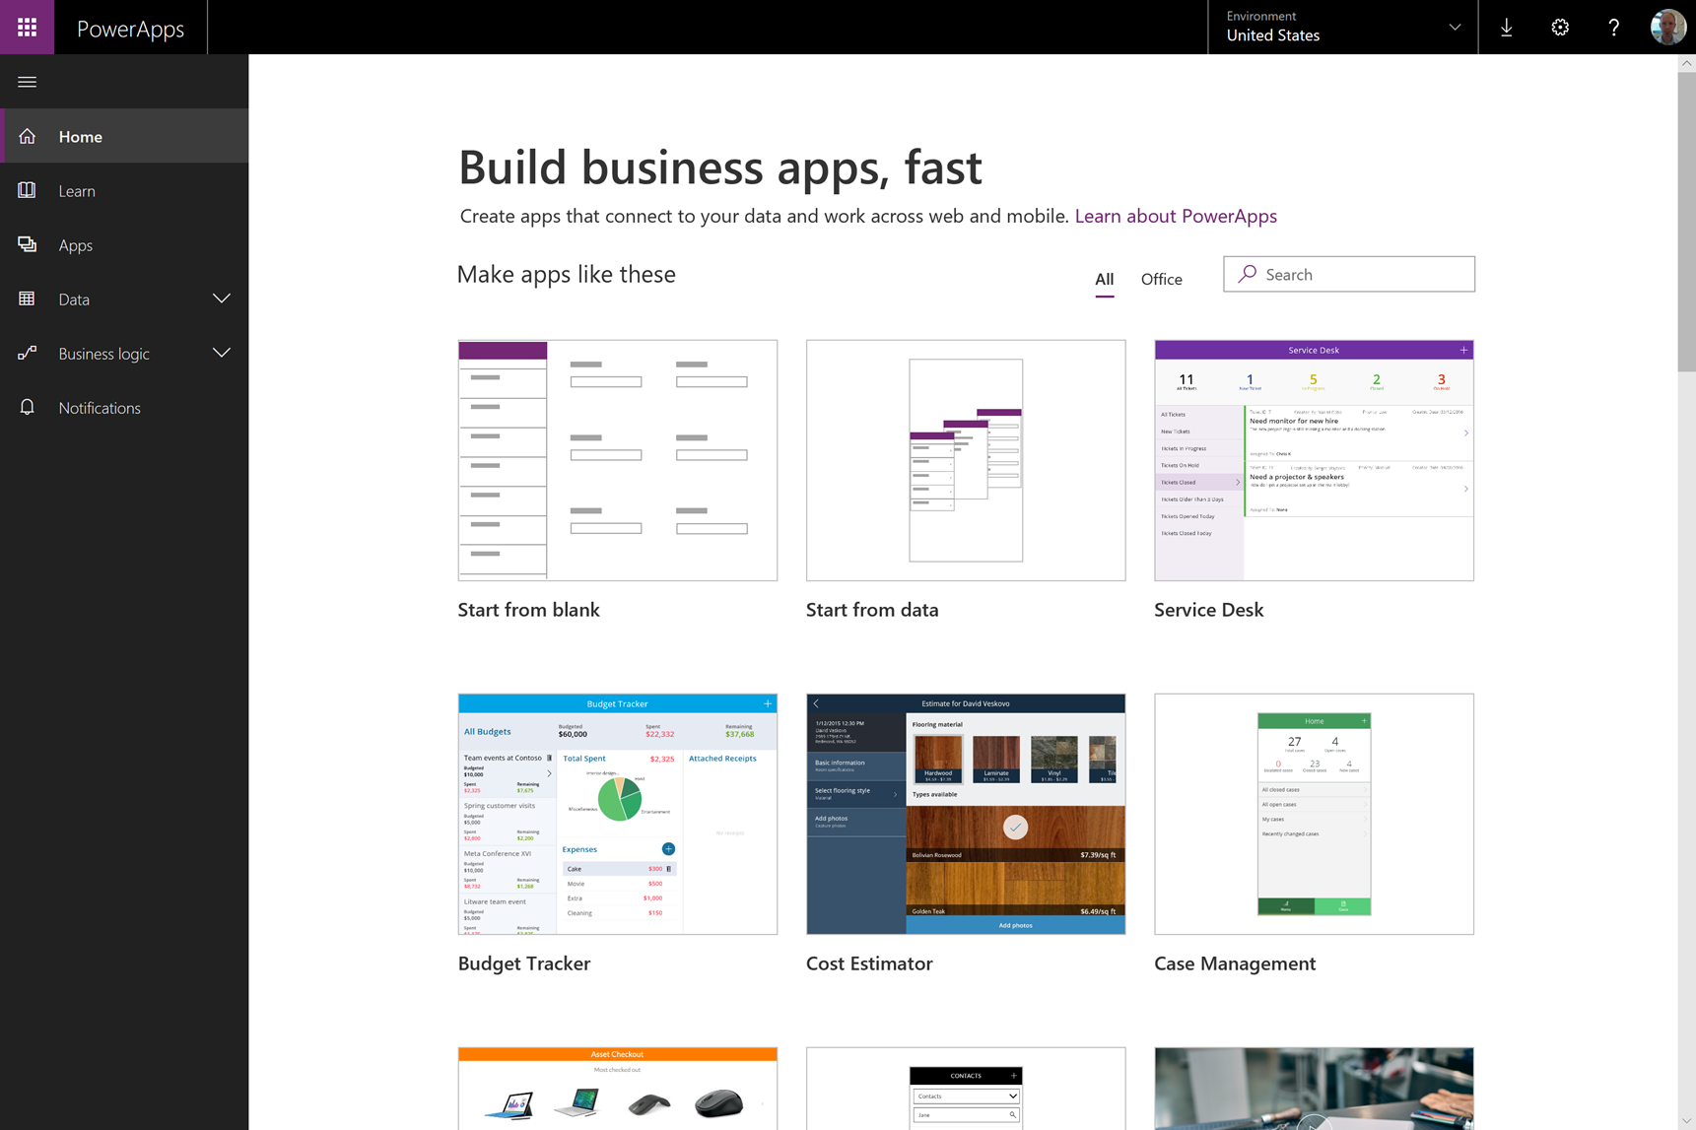
Transform Business Process
SharePoint connector for PowerApps and Flow Integration
Document approval and feedback flows
Automate file workflows in OneDrive
Create custom forms in SharePoint with PowerApps
Display Microsoft Forms on pages
Work easily with large lists and libraries
Manage documents at scale with attention views
Notes:
Microsoft Flow
Create automated workflows between your favorite apps and services to get notifications, synchronize files, collect data, and more with Microsoft Flow.
PowerApps
Easily build the business apps you need and extend or customize the apps you already use with PowerApps.
Attention views – required missing data on large lists or libraries
Bulk metadata editing
Intelligent content services – graph powered recommendations – predictive indexing and querying
• Flow for Cognitive Analysis - Process any text for sentiment, key phrases, translation or moderation [Available Now] • Image Analysis - Create immersive formatting for any list or library with scripting [Available now] • AI for Images - Teach the cloud to recognize new objects for auto-tagging [Available Now] • New ways to create lists - Create lists based on Excel, templates, or other lists [Available later 2018]

Slide 27
Harness Collective Knowledge
Notes:
More than ever, how people interact with technology is much more than “look and feel.” Great experiences are those that look great and work flawlessly. They entertain and engage, with rich, contextual, and relevant content. They are easy to use. And they ensure reliability, performance, and security under real-world pressures of scale and complexity.

Slide 28

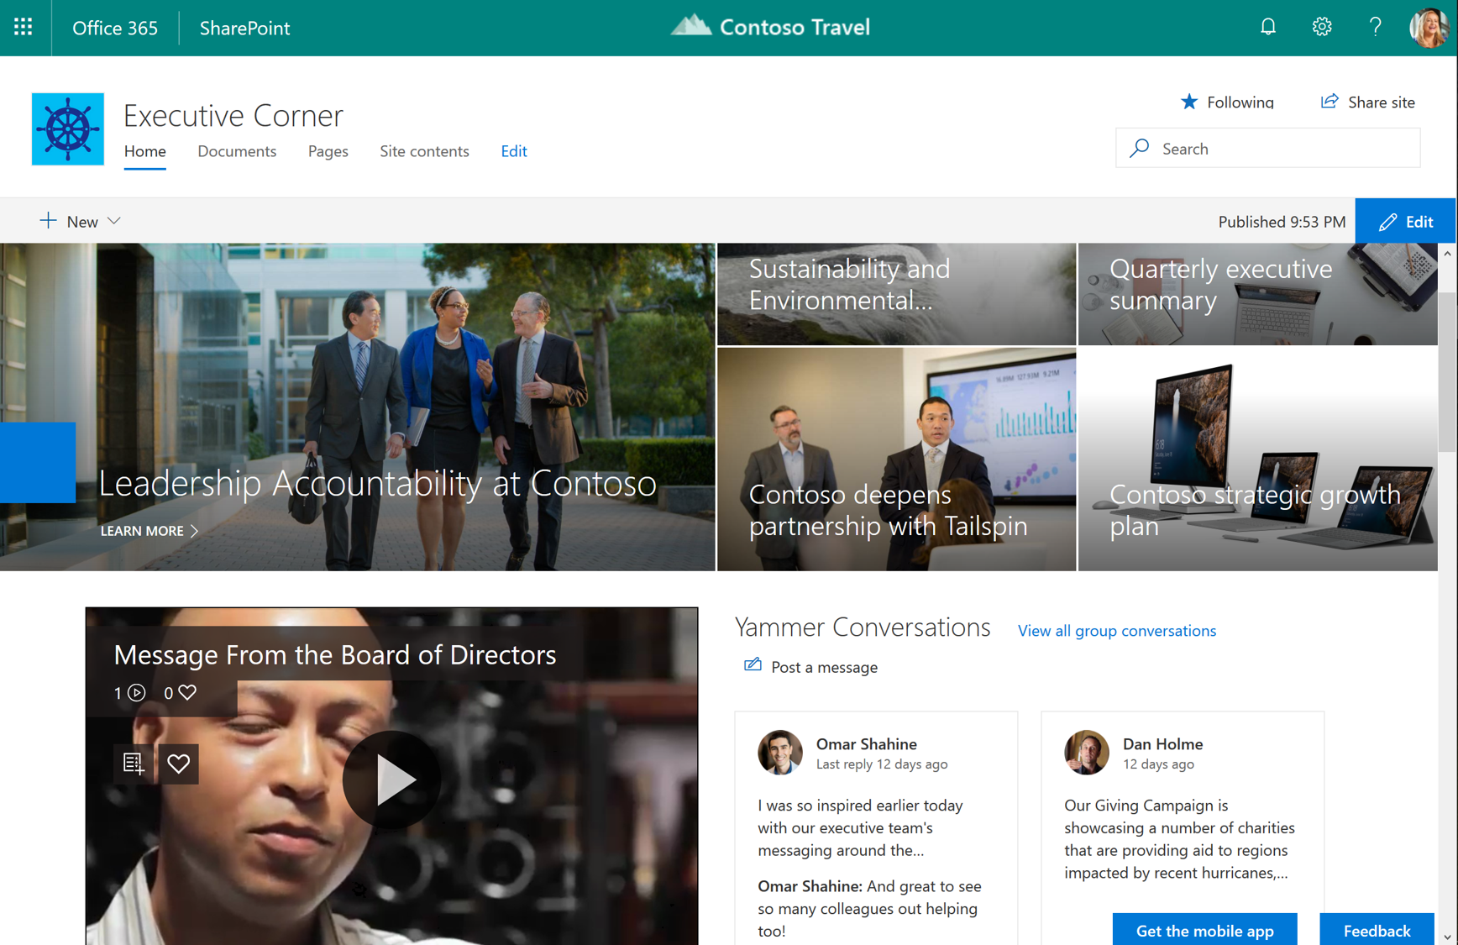
Foster communities for knowledge sharing
Communication sites make it easy to bring together many sources of information, in a simple and beautiful format
Integrate video from Stream, keep and sustain community with conversations in Yammer
Create pages, feature articles and news and promote them easily
Include a wide number of range of sources including Salesforce, Trello, Bing News feeds with web parts (including Forms, Twitter and Office 365 connectors)
Search discovers content in news and lists, in addition to documents
Notes:
Build Communities of practice or interest connect people across the organization by enabling people to share content, stay updated with news and announcements, and to network, engage, and exchange ideas and best practices.
Knowledge Management
Create a community with a SharePoint communication site and an integrated Yammer feed.
You can use a specific group in Yammer as well as a topic feed.
Share content in the site’s document library, data in lists, and curate resources from across the intranet and the internet with highlighted contents and links web parts.
Use skill search to identify experts across your organization and highlight them in your community with the people web part.

Slide 29
IT control
Notes:
SPEAKER NOTES
Ever-changing business conditions require you to be agile, and that means investing in solutions that provide reliability and choice. SharePoint Online provides the flexibility to tailor deployments based on your unique business needs.
SharePoint Online allows you to maximize the value of your existing infrastructure while enabling you to take advantage of the latest hardware innovations and computing technologies—making it capable of handling enormous amounts of data faster, more efficiently, and at a lower cost.

Slide 30
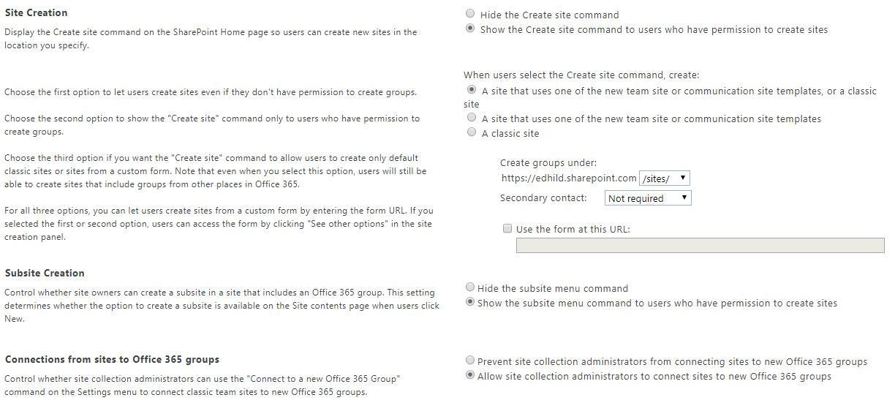
Admin Controls for how site creation works

Slide 31
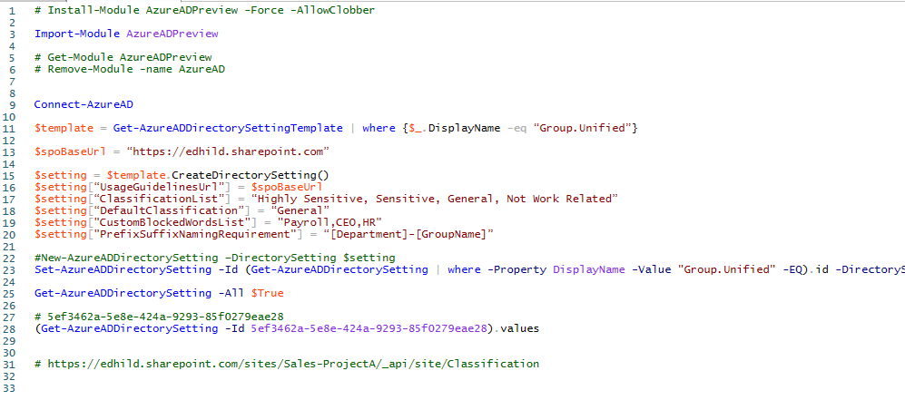
Adding Governance to Site Creation

Slide 32
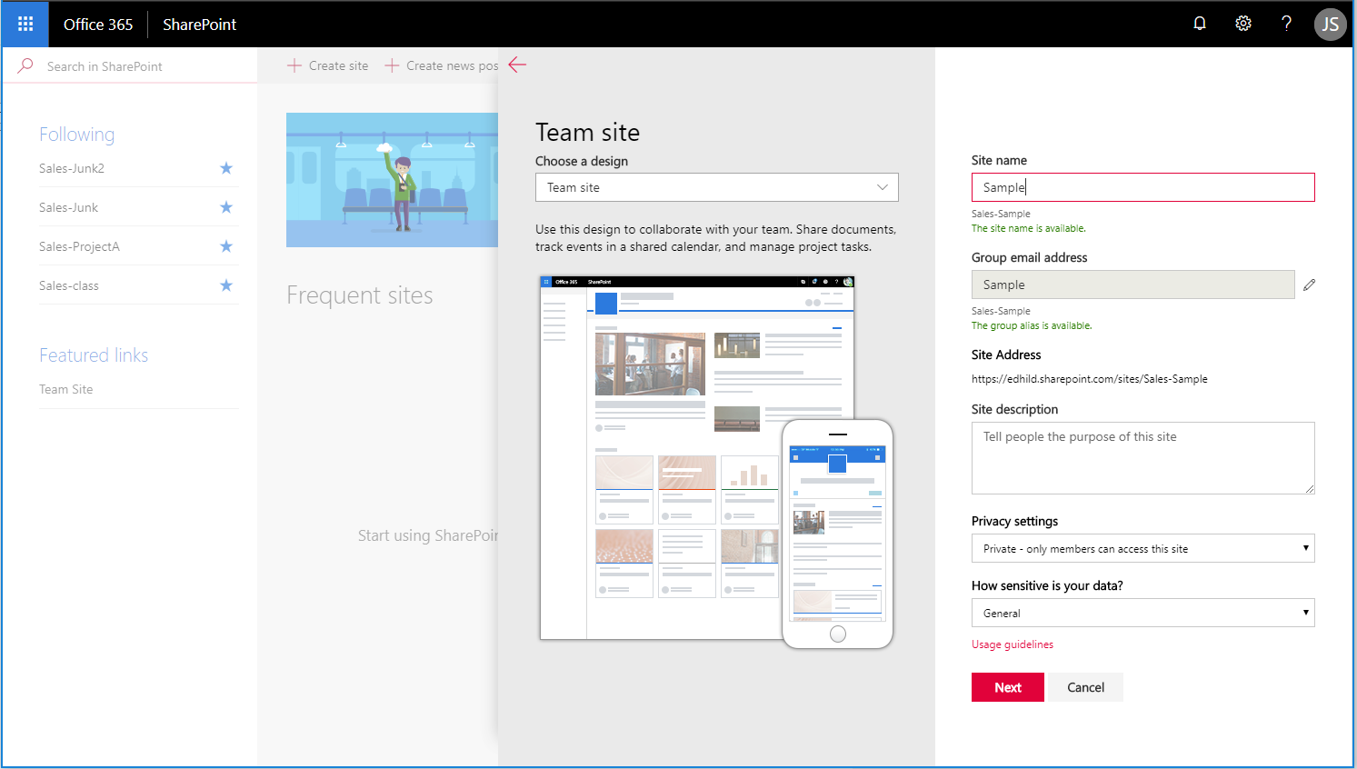
Notes:
See how this is tied to an Office 365 Group – it gets a Group email address
Naming convention in this case is putting the department name in the URL
Privacy settings
Classification
Usage Guidelines

Slide 33
Important Hub Sites PowerShell Commands
Register-SPOHubSite url Converts a site to a hub site and enables hub features
Grant-SPOHubSiteRights -Identity -Principals GroupEmail -Rights Join Controls which users are allowed to establish the join of an associated site
Add-SPOHubSiteAssociation –Site url –HubSite url Establishes a new association between site and the hub (can also be done in the browser)
Notes:
Also you can set up approvals for hub sites

Slide 34
Extend & Develop
Notes:
SPEAKER NOTES
SharePoint’s rich solutions ecosystem is one of its greatest assets, and we recognize that there are opportunities to meet the evolving needs of developers in the mobile-first, cloud-first world.
As a developer, you have new scenarios to create contextual solutions that span SharePoint Online and Office 365 from the web, mobile apps, and Office. You have new robust APIs and tool improvements to make building solutions easier than ever before. And your solutions have the potential to reach a vast number of users across businesses, government organizations, and schools, who spend hours every day using Office on-premises or in the cloud with Office 365.

Slide 35
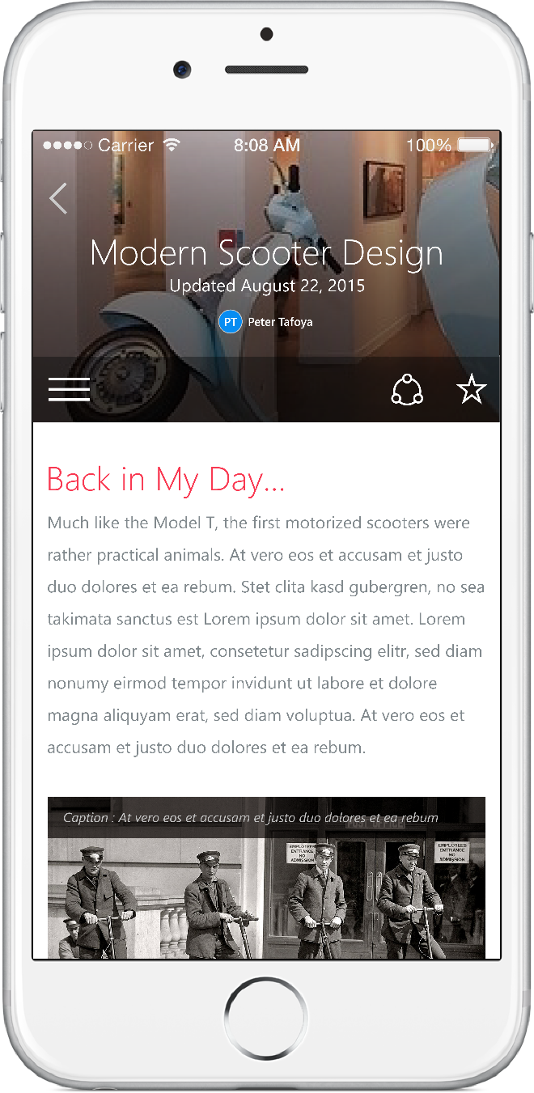
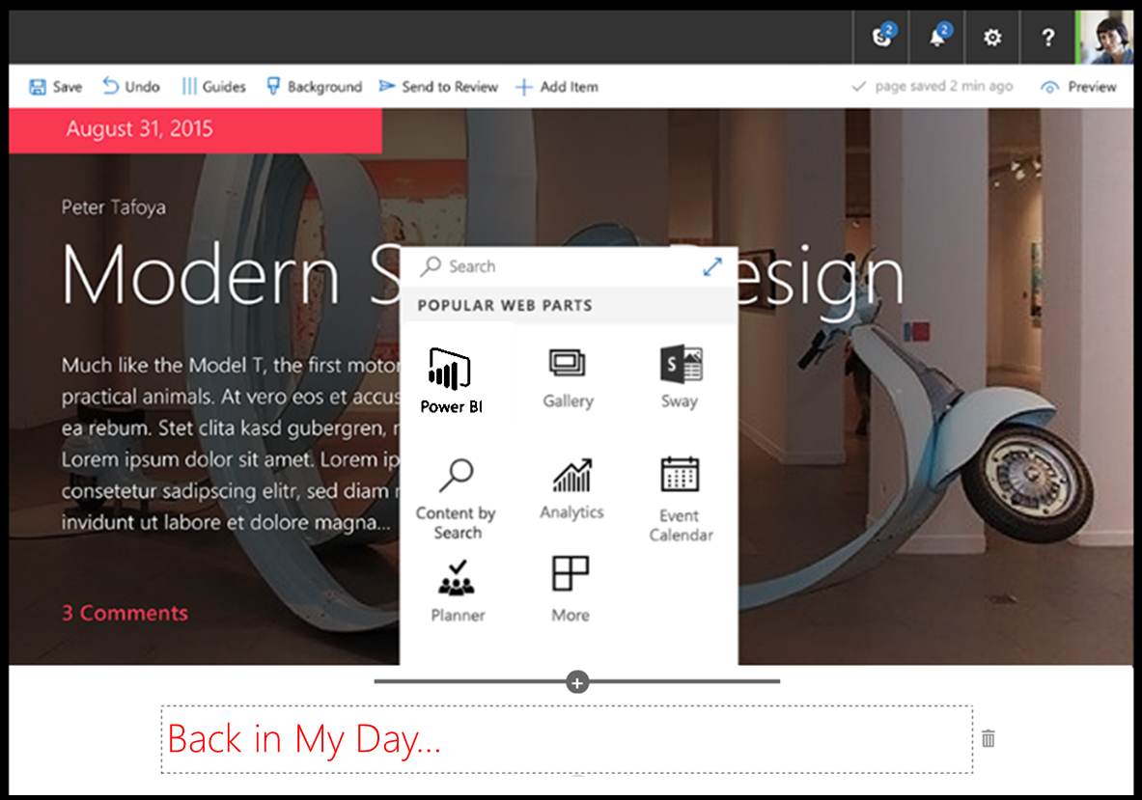
SharePoint Framework
Modern client-side development
Lightweight web and mobile
Powers our own experiences
Backward compatible
Supports open source tools and JavaScript web frameworks
SharePoint framework
Microsoft Graph
LOB Systems and Cloud Services
Notes:
SharePoint Framework
A page and web-part model that enables fully supported client-side development, easy integration with the Microsoft Graph and support for open source tooling.
The SharePoint Framework delivers a new client-side rendering framework leveraging open source JavaScript technologies.
The client-side development framework allows developers to use modern JavaScript and web templating frameworks across cloud and on-premises SharePoint.
The SharePoint Framework embraces the tools, frameworks and open source initiatives that developers rely on today, and it extends the scope of solutions that can be built on SharePoint, on-premises and in the cloud.
Built into the SharePoint mobile apps
Extensions
The ability to build responsive, fluid web parts using modern web developer tools and techniques expands the audience and opportunities for all developers to tailor their SharePoint sites.
SharePoint Framework Extensions add new capabilities to extend the user experience of SharePoint within modern pages and document libraries, while leveraging the familiar tools and libraries for client-side development coming from the SharePoint Framework.
Extend business applications with modern tools and frameworks
Single end-point for sites, files, and beyond with Microsoft Graph

Slide 36
The Modern Experience
Creating a Modern Site
Tour of Modern Team Site
Authoring Experience
Modern Lists and Libraries
demo
Notes:
Contoso Portal Home
Post and alert
Personal Home
Create a New “Contoso Team Site” design from the SP Home Page or in Outlook
talk to site script
association to hub site / inherits branding
adds extension web parts
(If interest / time – show powershell)
View the home page
Post a news article; show authoring experience
View a Document Library
Show on Mobile Device

Slide 37

Thank you

